Slide 1
Analysing Neighbourhoods of Manchester For Starting A New Restaurant.
Shaban Khan
IBM Applied Data Science
03.01.2020

Slide 2
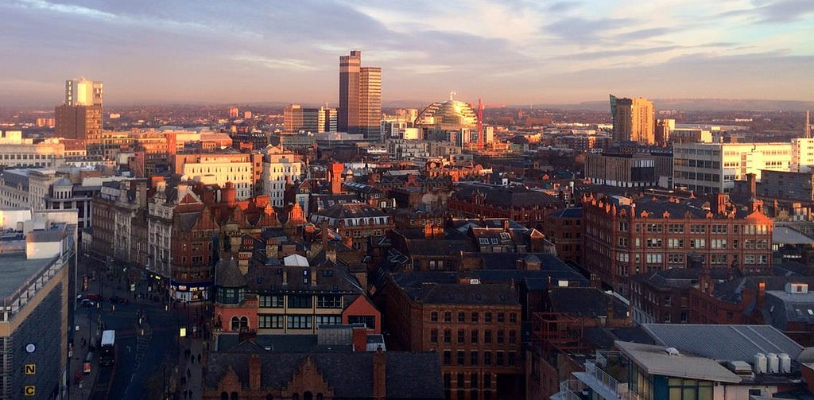
Introduction
Manchester: One of the biggest cities in UK
United Kingdom's second-most populous urban area, with a population of 2.9 million
The population comprises of people of various ethnicities from all over the world

Slide 3
Business Problem
Start a restaurant
Neighbourhood that is most likely to give a good business

Slide 4
Data
Neighbourhoods of Manchester
Neighbourhoods of Manchester wikipedia page through data scraping.
Geographical coordinates of the neighbourhoods
Using GeoPy library.
Venue data from FourSquare
Using FourSquare API

Slide 5
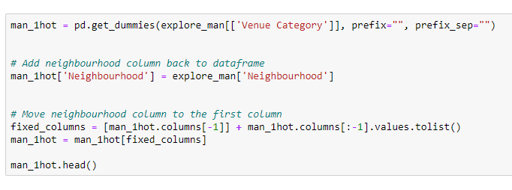
Methodology
Feature Extraction
One Hot Encoding

Slide 6
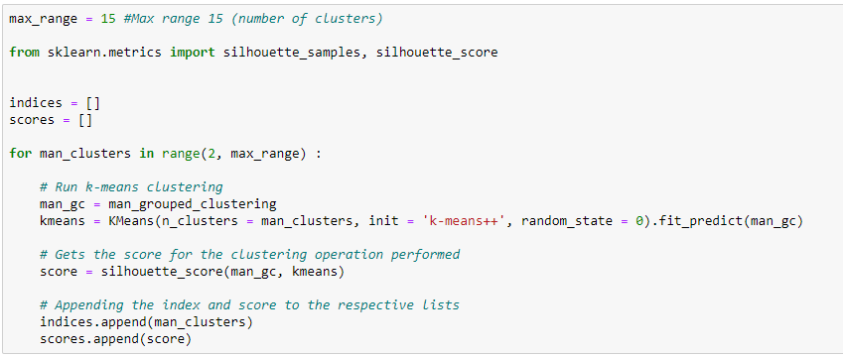
Unsupervised Learning
K-Means Clustering

Slide 7
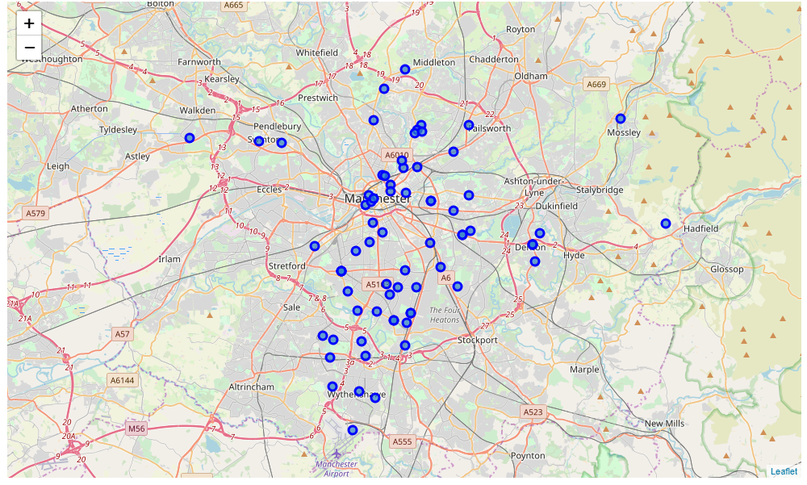
Plotting
Folium

Slide 8
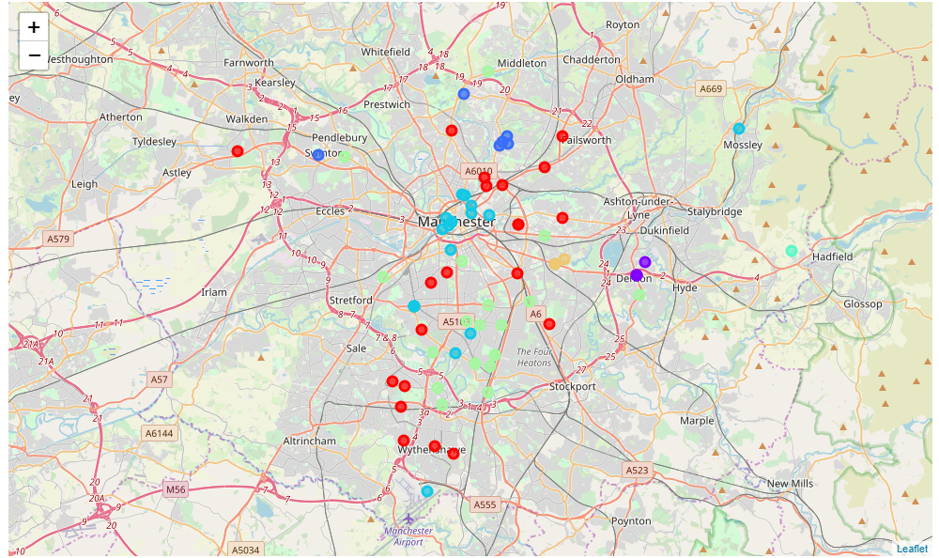
Results
Visualization of clusters
After visualising the clusters, the individual clusters were studied and some important conclusions were derived. The neighbourhood that had the most number of restaurants was cluster number 4.

Slide 9
Discussion
Most suitable neighbourhoods for starting the restaurant business are present in the cluster number 4.
Our K-Means model worked perfectly and successfully clustered similar neighbourhoods together.
After studying all four clusters, it is recommended to the client that neighbourhoods such as Barlow Moor, Brookelands and Hyde Newton (Ward) that fall in cluster 4 look like good locations for starting their restaurant business.
The client can go ahead and make a decision depending on other factors like availability and legal requirements that are out of scope of this project.

Slide 10
Conclusion
Data analysis and machine learning techniques used in this project can be very helpful in determining solutions of certain business problems.
Python’s inbuilt libraries such as GeoPy, Folium and BeautifulSoup make it very easy and effective to analyse a geographical location.
In this project we studied the neighbourhoods of Manchester city and came up with a recommendation of neighbourhoods where our client can start their restaurant business.

